Slide 1

Helpful hallway
By Tuur Baele
Pieter de Block
Rijad Šehović
Thomas Wauters
Notes:
Good afternoon, in this presentation we will be presenting the final result of our “Helpful hallway” project and how we achieved this.

Slide 2

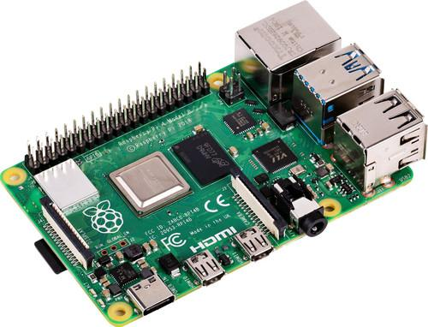
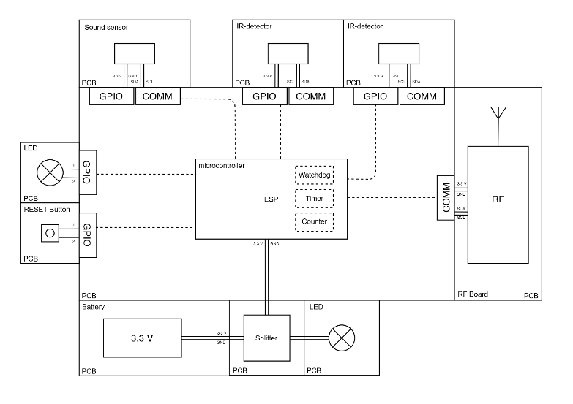
System overview
Server
Node
MQTT
Notes:
The goal of our project was to make a system that allows students to navigate the hallways more quickly and with less traffic.
We try to accomplish this with the following system. In every hallway a node will be placed that is powered by a battery and connected to a wifi network, which will make the placement of the system very easy. These nodes will each have a microphone and two infra-red camera’s. The microphone will be used to wake up the node from it’s lowest power mode and the infra-red camera’s will be used to check the hallway traffic, and each camera will be covering a section of the hallway. The traffic in the hallway will then be send to the server, where the data will be saved in a database and visualized where the students access it easily.

Slide 3
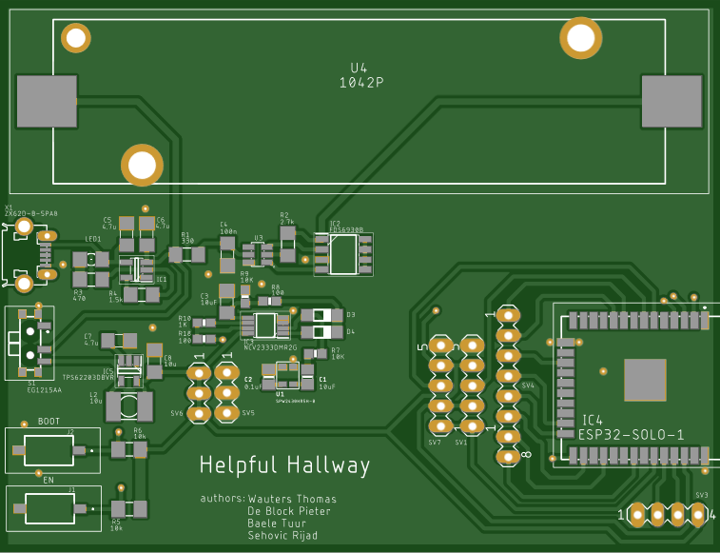
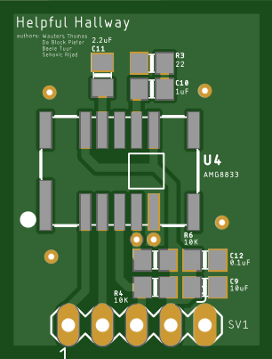
PCB
Main PCB with Battery + management Microcontroller + wifi Microphone + amplifier +amplitude detector
IR camera on second PCB
Notes:
One of my responsibilities for the project is the design of the PCB. For this we have chosen to make a main PCB and separate PCB’s for each of the infra-red cameras. This way we can position the camera’s better to cover the entire hallway. All other components for the power, communication, microphone and computing will be placed on the main PCB.

Slide 4
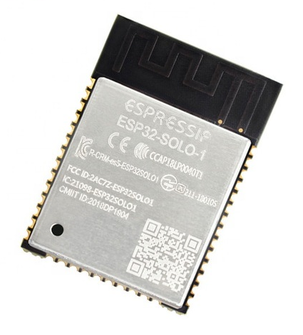
ESP32-SOLO-1
Single core microcontroller
ULP coprocessor
Wifi module Enterprise network
Notes:
For the microcontroller, we have chosen an ESP32. This particular model has a single core as well as an ultra low power coprocessor which allows us to increase the battery life of the device a lot. This chip also has a wifi module built in and it supports enterprise wifi networks so it will be able to connect to the campus’ network.

Slide 5
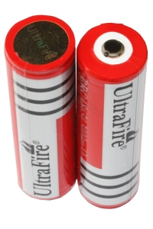
Battery management
18650 Li-ion battery, 3.7V, 3000mAh
Controlled charging/discharging on PCB
Micro-USB
Notes:
For the battery we have chosen for a standard Lithium ion cell, which has a relatively low self-discharge and will be able to power the node for a long time. This battery is rechargeable and this is implemented on the PCB. A micro-USB connector is placed on the board to make the charging the nodes very easy for the user. The necessary protections for charging and discharging are also implemented on the board to make the device safer and increase the battery’s lifespan.

Slide 6
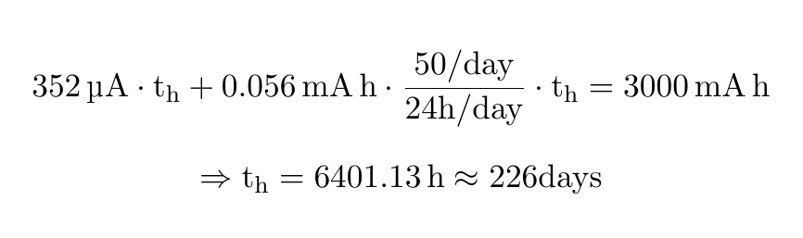
Power usage
Battery: 3000 mAh
continuous power usage: ± 352 μA
Power usage while measuring and sending: ± 100 mA for 2 s → 0.056 mAh, 50 times a day
Notes:
We have tried to make the device last as long as possible with one battery. Due to the circumstances, we haven’t been able to measure all parameters but by combining the measured data with the information from datasheets, we get the following result. We get a power usage during sleep of around 350µA which is largely because of the two infrared cameras but also from the microcontroller, the microphone and losses like self discharge of the battery. During the normal operation of the device, we estimate that it will use around 50 micro amp hours every time it wakes up to measure and send data and this 50 times a day on average. This will result in a battery life of 226 days which is better than the requirements we initially proposed.

Slide 7
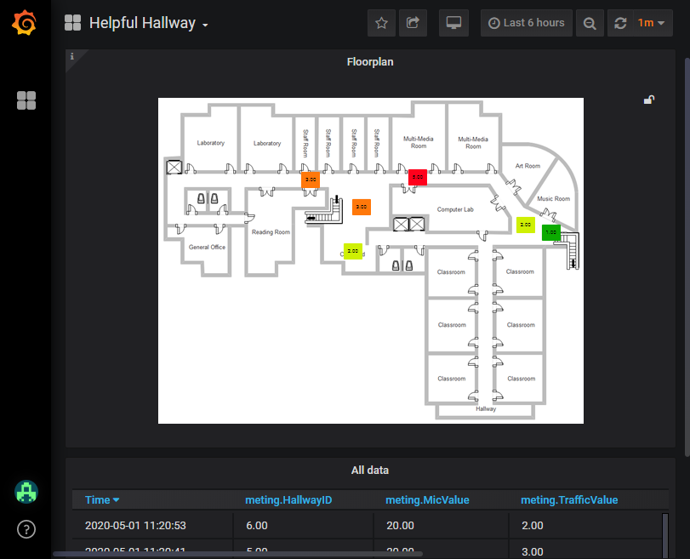
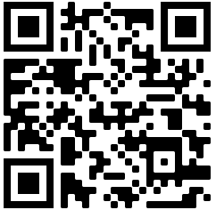
Server
Raspberry Pi
Mosquitto broker
InfluxDB
Grafana
http://helpfulhallway.duckdns.org:3000/
Notes:
To implement the server, we use a Raspberry Pi. On this the MQTT broker, the database and the application are running. We chose Mosquitto as the MQTT broker and when a message arrives, a python program we have written will place the message in the InfluxDB database. We chose the open source software Grafana to make a dashboard where all the data is visualised. As you can see picture all the data is represented in a floor plan where the traffic in every hallway is be represented as a color.
And now Tuur will tell you some more about what he has been working on for the project.

Slide 8
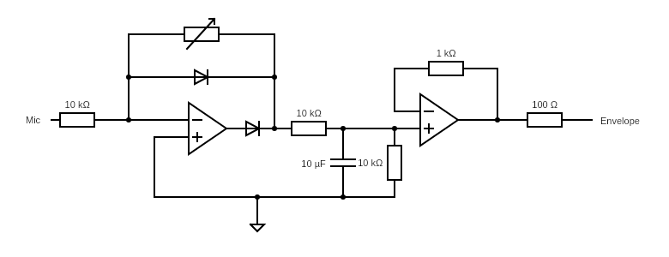
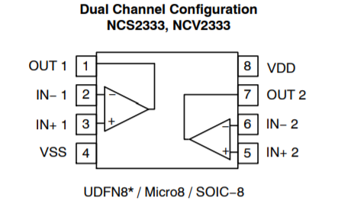
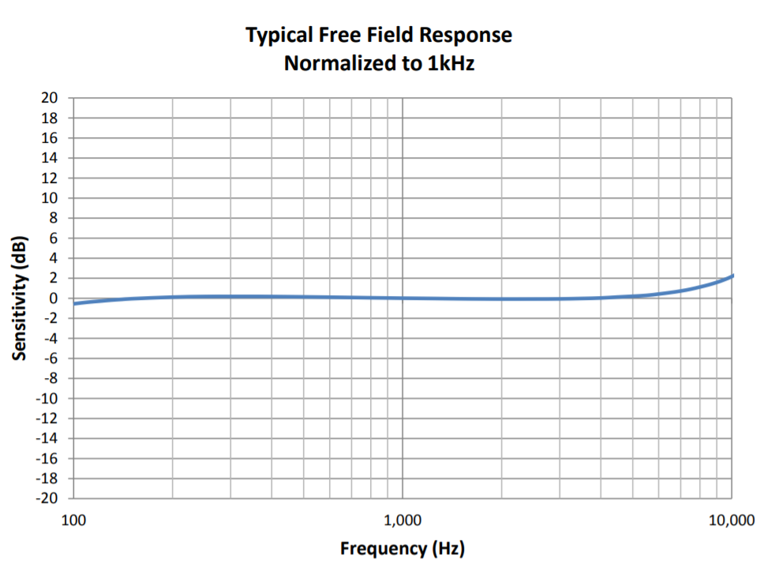
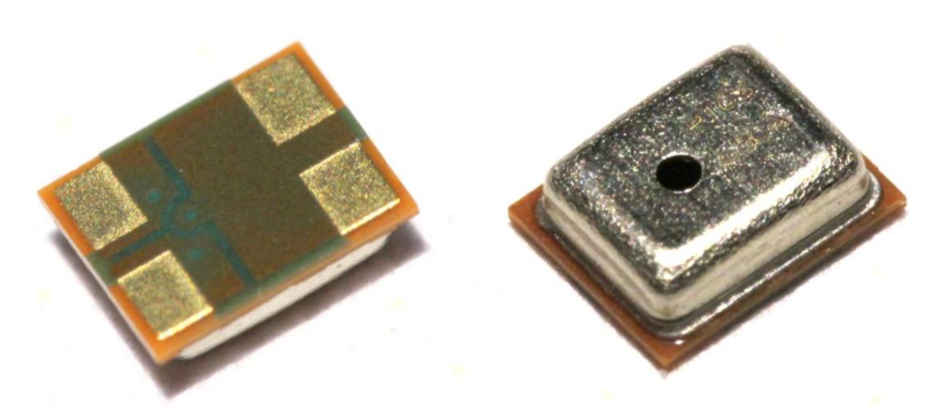
Audio sensor
Half-wave precision rectifier
17 µA @3.3V
Omnidirectional
MEMS technology
75-110µA @3.6V
Top Port SiSonic Microphone

Slide 9
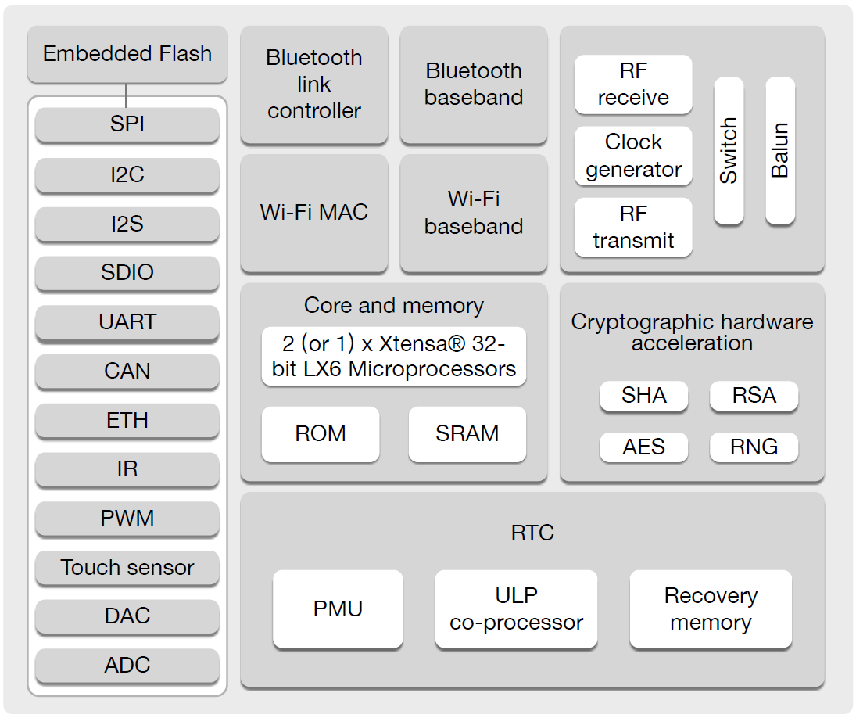
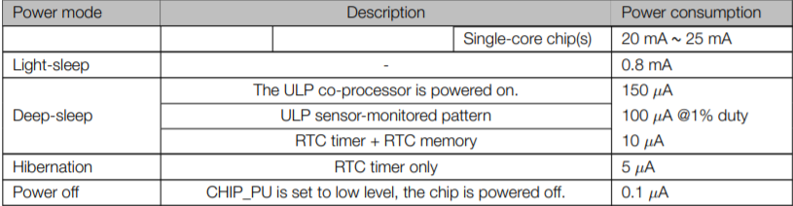
Using the ULP Co-processor
Routine
If above
Checks threshold
Every 500ms
Wakes up main CPU core
Programmed using assembly
Using 12-bit SAR ADC
In Deep-sleep mode

Slide 10
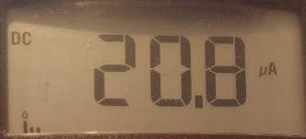
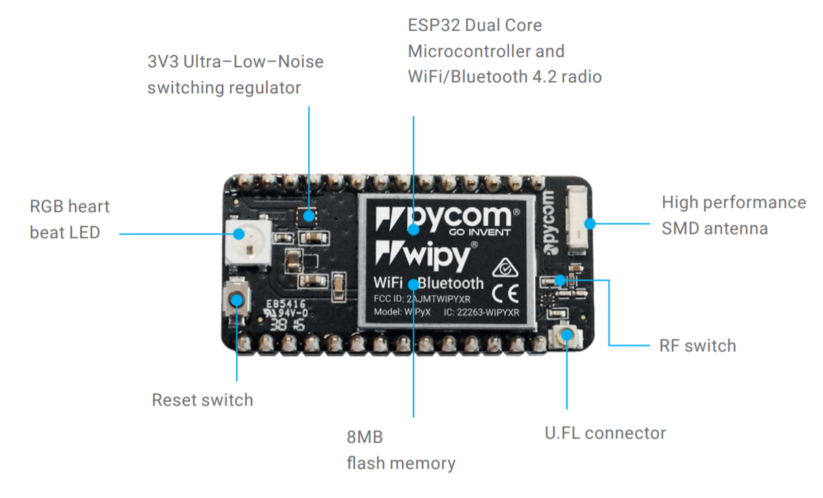
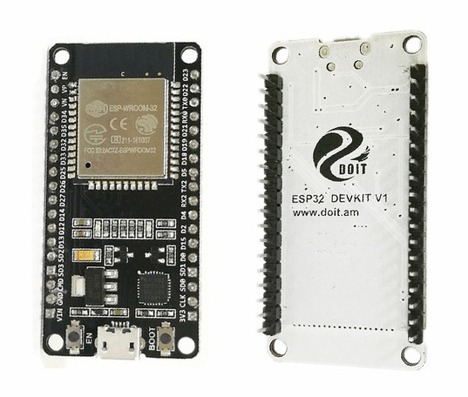
Promising ULP audio monitoring results
Power:
±1µA
Deep sleep ~25 µA (datasheet)
Using:

Slide 11
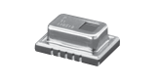
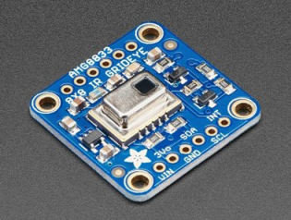
IR sensor
AMG8833 (Grid-EYE (AMG88))
MEMS technology
64 pixels (8 x 8)
Max distance: 7 m
Energy Mode:
Normal: 4.5 mA
Stand-by: 0.8 mA
Sleep: 0.2 mA
Times:
Enable communication after setup: 50 ms
Stabilize output after setup: 15 s
Adafruit_AMG88xx library

Slide 12
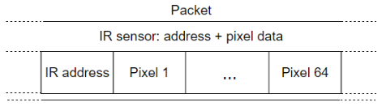
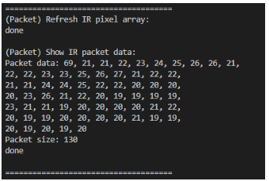
IR sensor
Packet option 1
System calculations: low
Packet size: 130 bytes
Consumption: medium

Slide 13
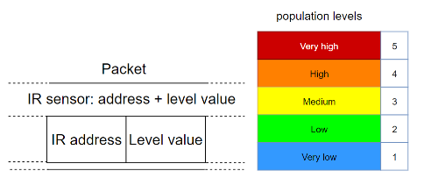
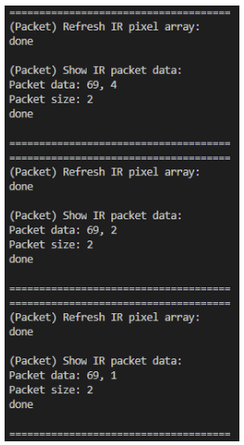
IR sensor
Packet option 2 (average value)
System calculations: medium
Packet size: 2 bytes
Consumption: low/medium

Slide 14
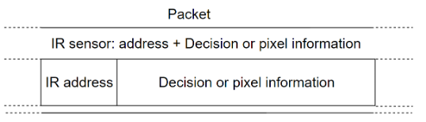
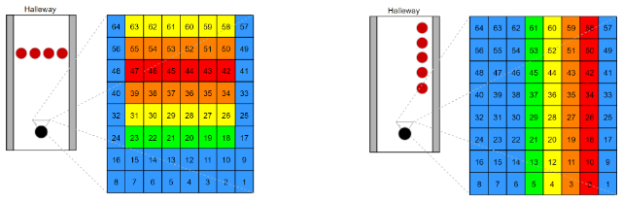
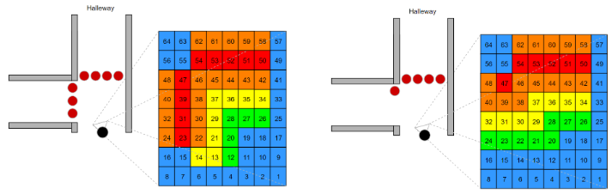
IR sensor
Packet option 3 (Suggestion)
System calculations: variable
Packet size: variable
Consumption: variable
Server: Lookup table

Slide 15







Wireless communication
Wi-Fi
MQTT
Mosquitto on Raspberry Pi

Slide 16
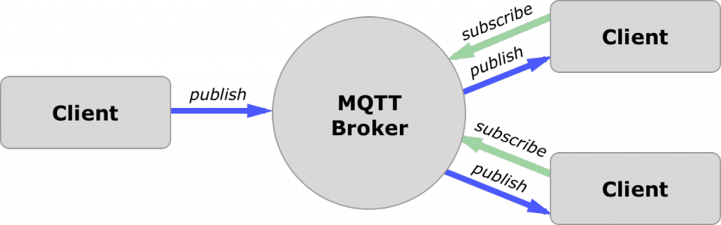
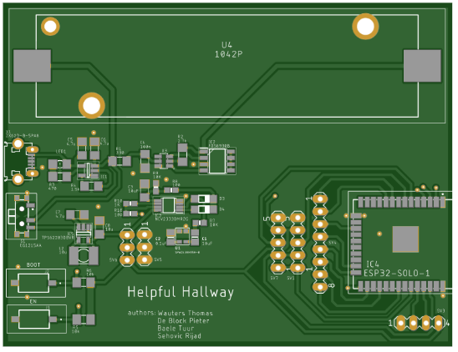
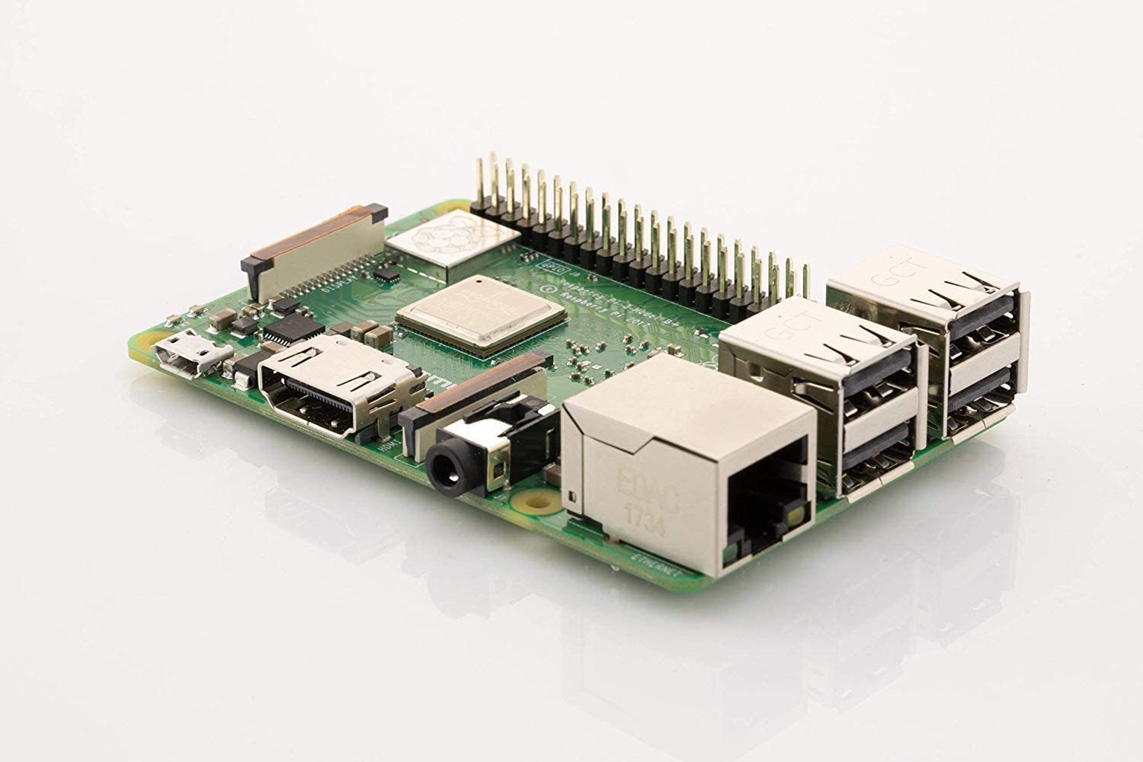
Wireless communication
PCB
Raspberry Pi

Slide 17
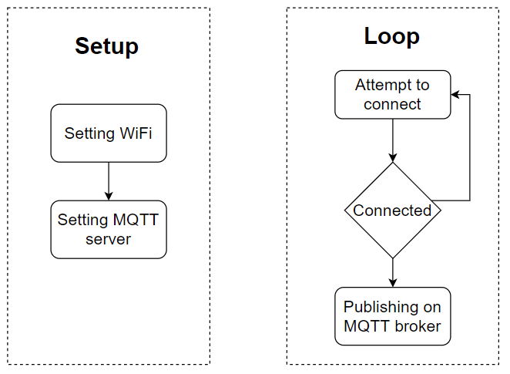
Wireless communication
Code diagram

Slide 18
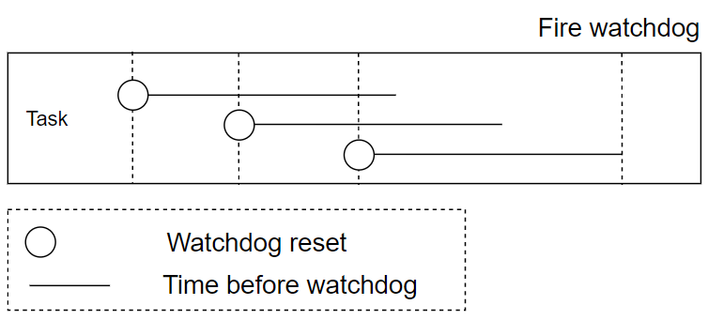
Watchdog
esp_task_wdt_reset (wdt: watchdog timer)
using: task system
https://docs.espressif.com/projects/esp-idf/en/latest/esp32/api-reference/system/wdts.html#interrupt-watchdog-api-reference
https://www.youtube.com/watch?v=C2xF3O6qkbg

Slide 19
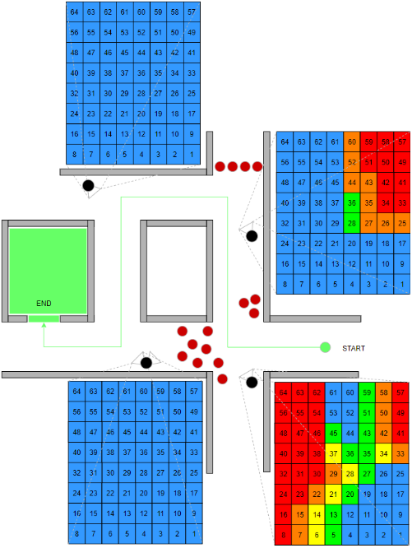
Future Possibilities
IR sensor:
Higher resolution
More sensors
App:
Guide users (see figure)
Measurements:
less during weekends and even classes

Slide 20
Future Possibilities
Analysing data
Find patterns

Slide 21

Conclusion
The body and the brain are still separated

Slide 22
Questions?

